Slide 1
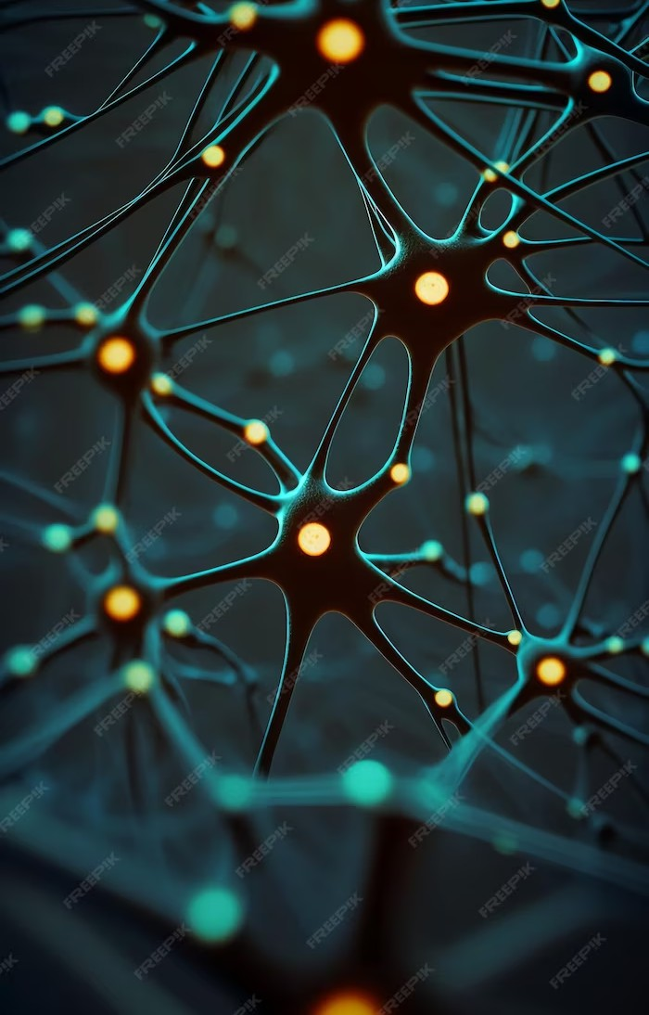
Unlocking the Power of Deep Learning: Emotion Detection
Team members :
Madhav Dhadwal (RA2111027010062)
Harshvardhan Tewani (RA2111027010032)
Shreyas Patil (RA2111027010072)
Link :Emotion-Detection-using-Deep-Learning/Emotion Detection at main · madhavdhadwal/Emotion-Detection-using-Deep-Learning (github.com)

Slide 2
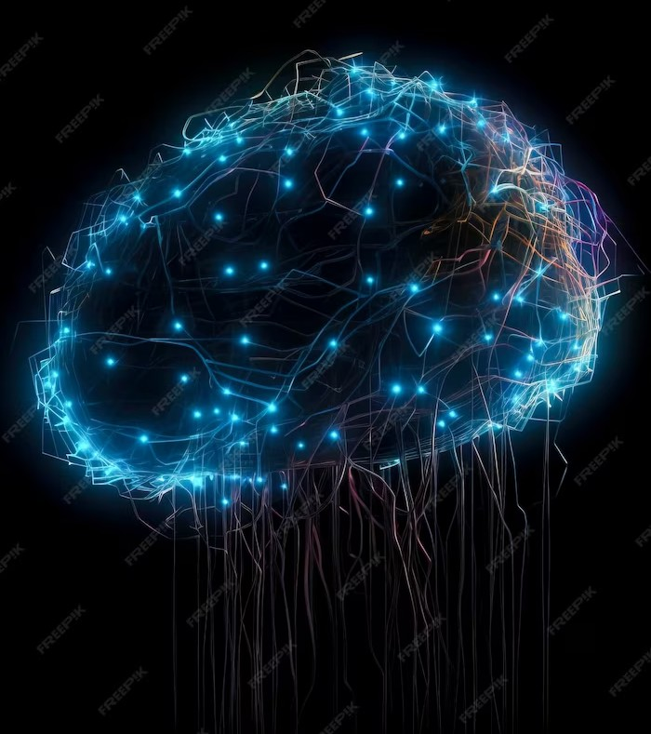

Introduction
: a subset of machine learning that mimics the human brain's neural networks. In this presentation, we explore the power of deep learning in . By analyzing facial expressions, voice tone, and body language, deep learning algorithms can accurately identify emotions.

Slide 3






Understanding Emotions
Emotions play a crucial role in human communication and decision-making.
enables us to gain insights into people's feelings and responses. Deep learning models can recognize emotions such as
, , , and
more. By understanding emotions, we can enhance empathy, improve customer service, and develop personalized experiences.

Slide 4
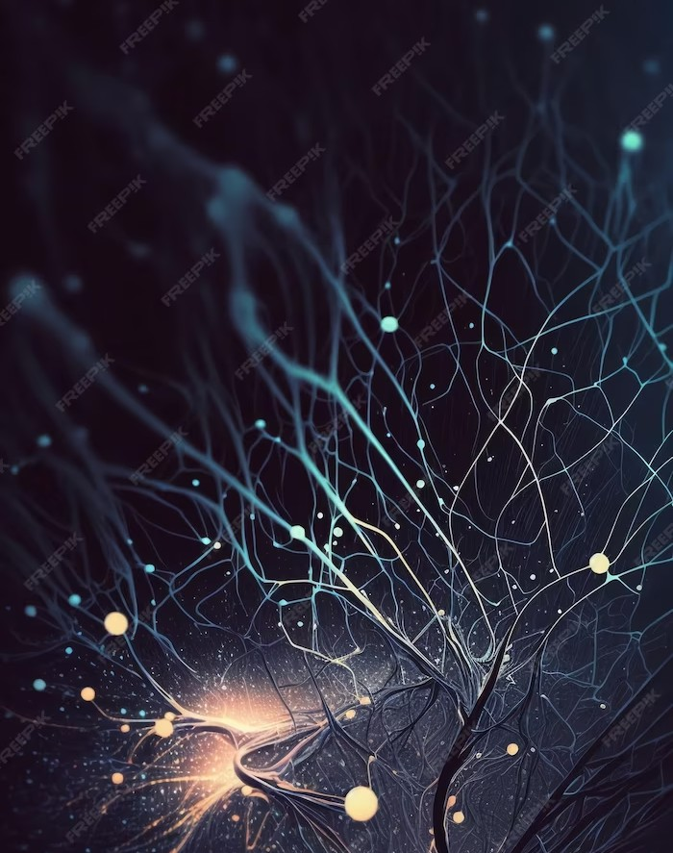





The Power of Deep Learning
Deep learning has revolutionized various fields,
including
and
. Its ability to learn from vast amounts
of data makes it ideal for emotion detection.
With deep learning, we can accurately analyze complex patterns in facial expressions, vocal intonations, and gestures. This technology opens
doors to new possibilities in
and human-computer interaction.

Slide 5
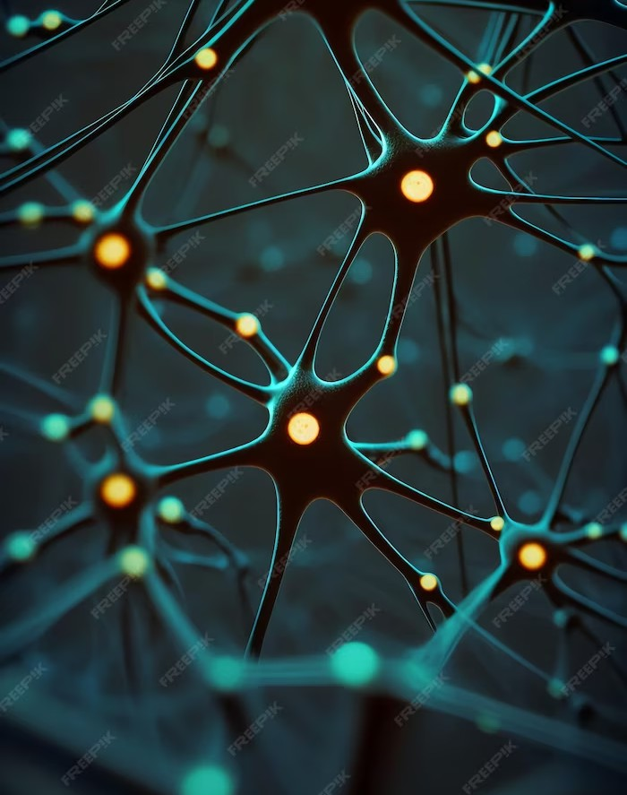
Emotion Detection Techniques
There are several techniques used in emotion detection, such as
(CNNs) and (RNNs).
CNNs excel in analyzing visual data, while RNNs are effective in processing sequential data. These techniques, combined with large emotion- labeled datasets, enable us to train deep learning models for accurate emotion detection.

Slide 6






Applications of Emotion Detection
Emotion detection has a wide range of applications. In , it can help diagnose and treat mental health conditions. In
, it provides insights into consumer preferences and reactions. can benefit
from emotion-aware systems that
personalize learning experiences. And in , emotion detection enhances virtual reality and gaming interactions.

Slide 7

Challenges and Limitations
Despite its potential, emotion detection using deep learning faces challenges. Variability in individual expressions, cultural differences, and context dependence can impact accuracy. Additionally, privacy concerns and ethical considerations arise when dealing with emotion data. Understanding these limitations is crucial for responsible implementation and further advancements in the field.

Slide 8
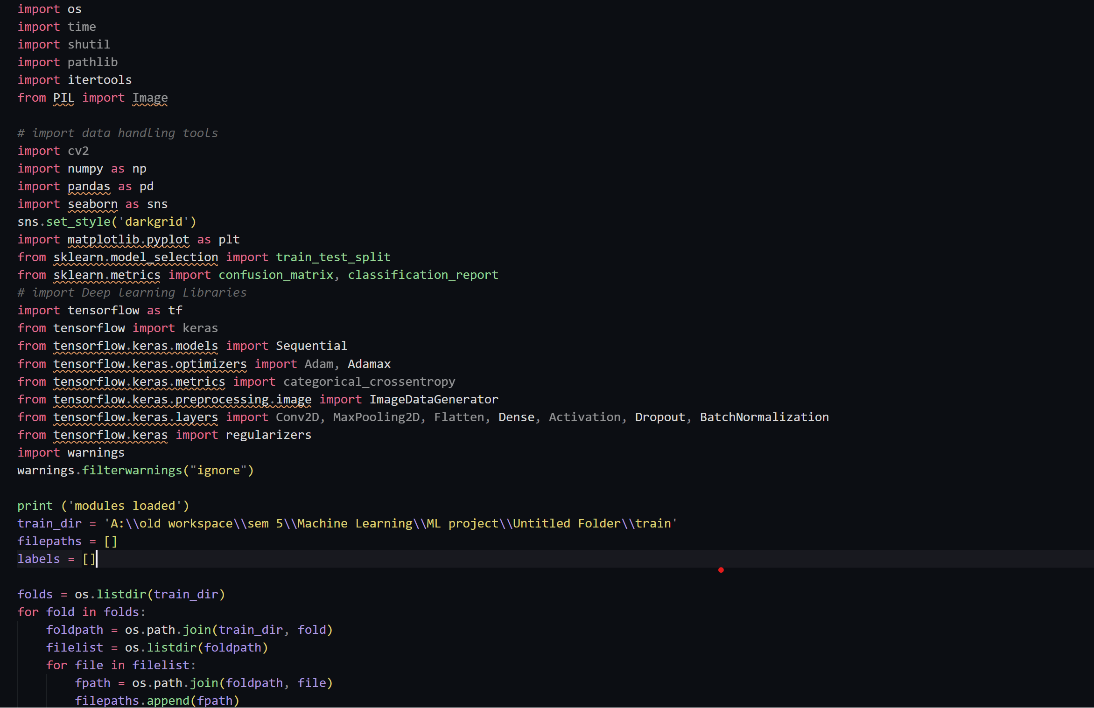
Code and output :
Link : Emotion-Detection-using-Deep-Learning/Emotion Detection at main · madhavdhadwal/Emotion-Detection-using-Deep-Learning (github.com)

Slide 9
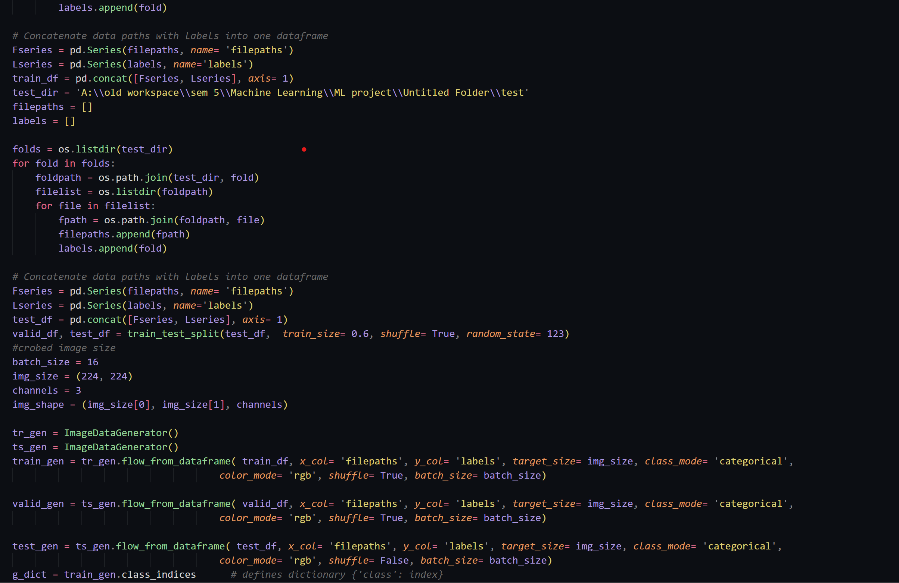

Slide 10
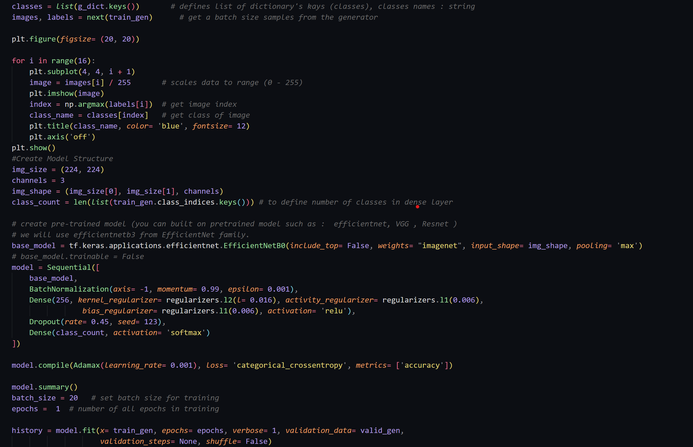

Slide 11
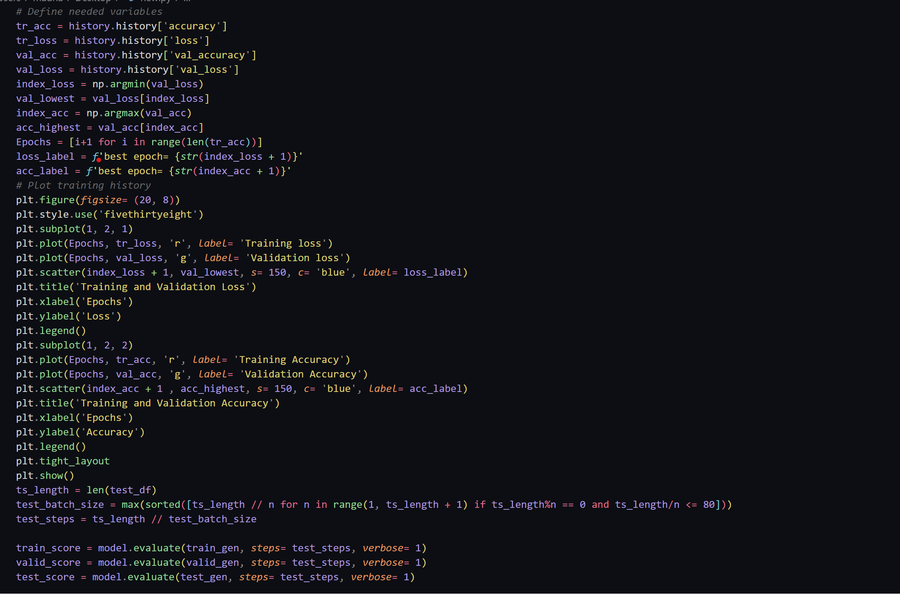

Slide 12
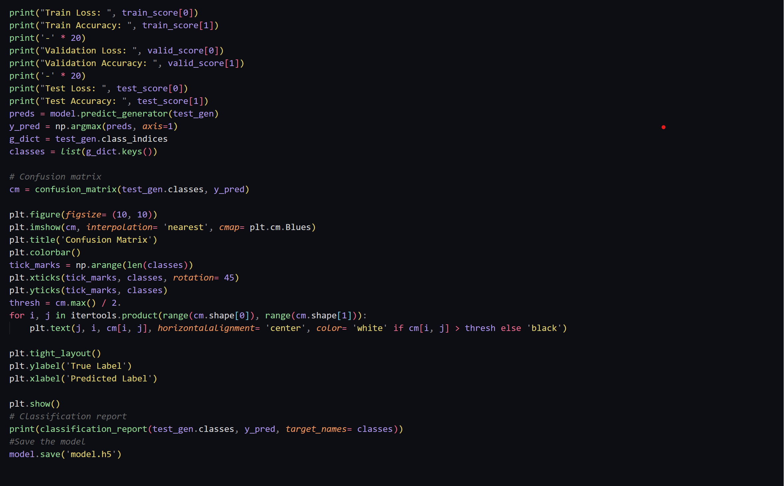

Slide 13
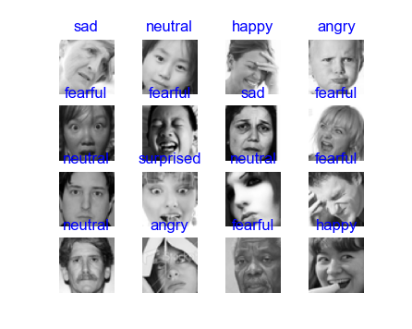
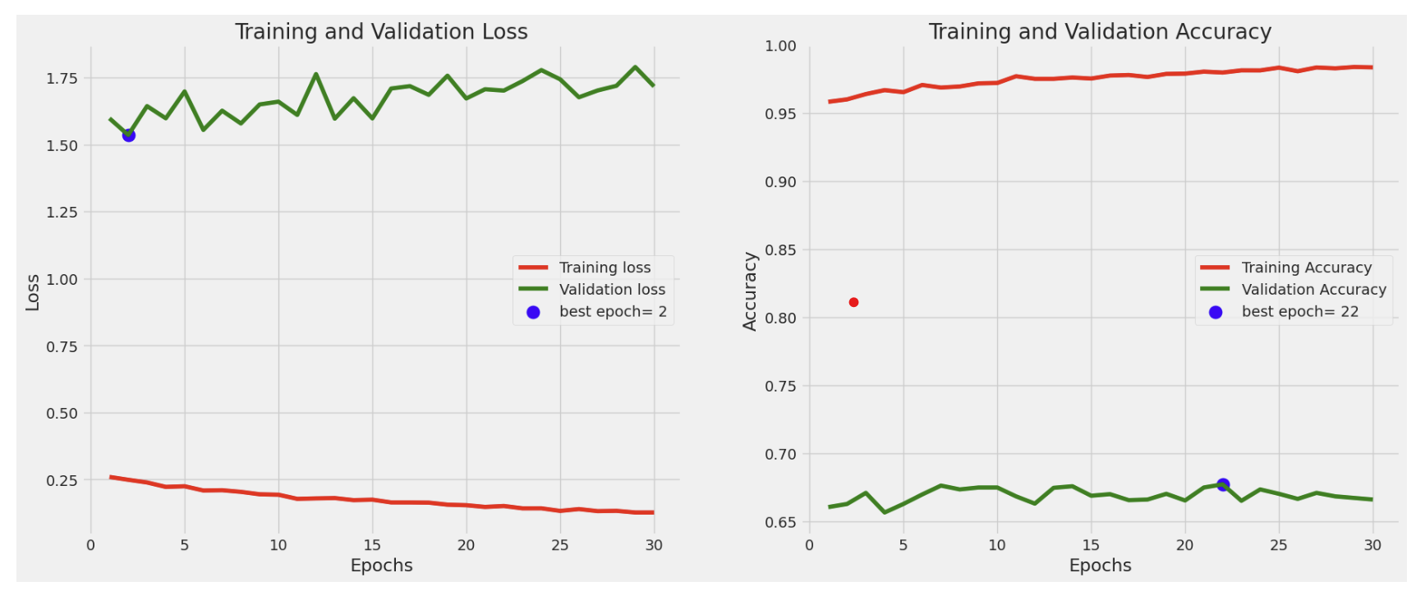
Output:

Slide 14
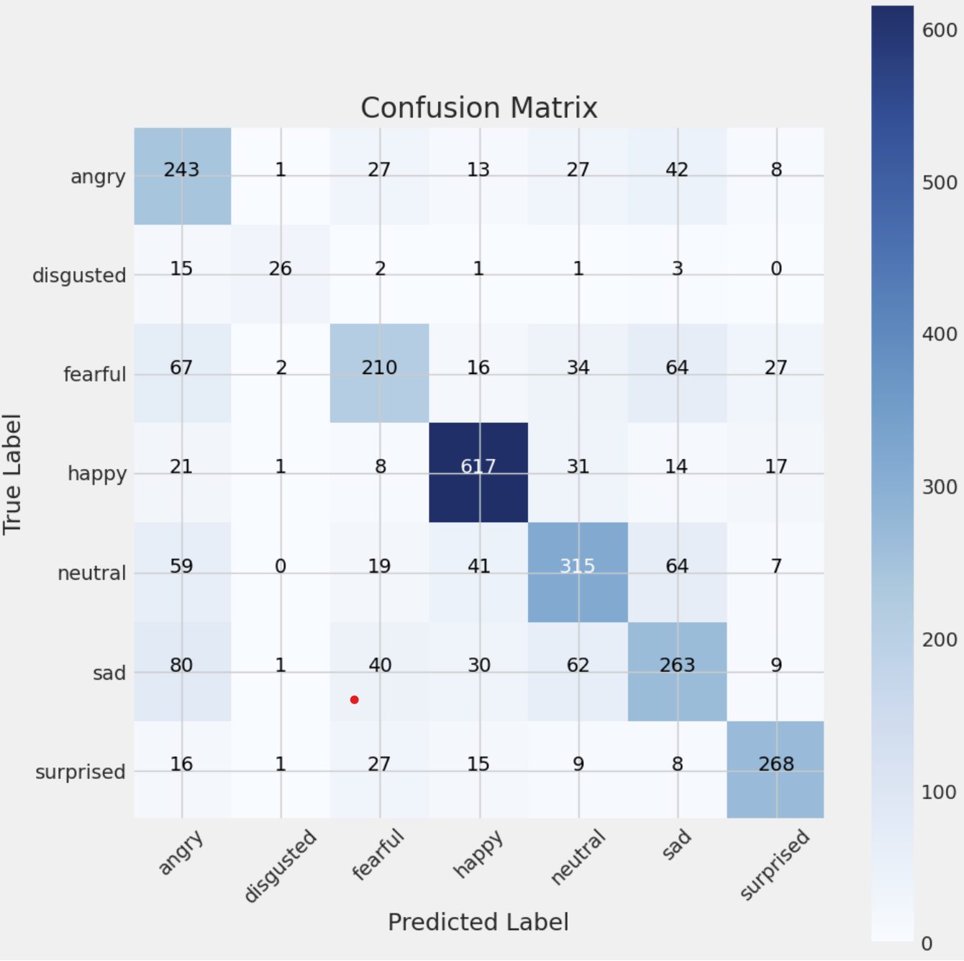
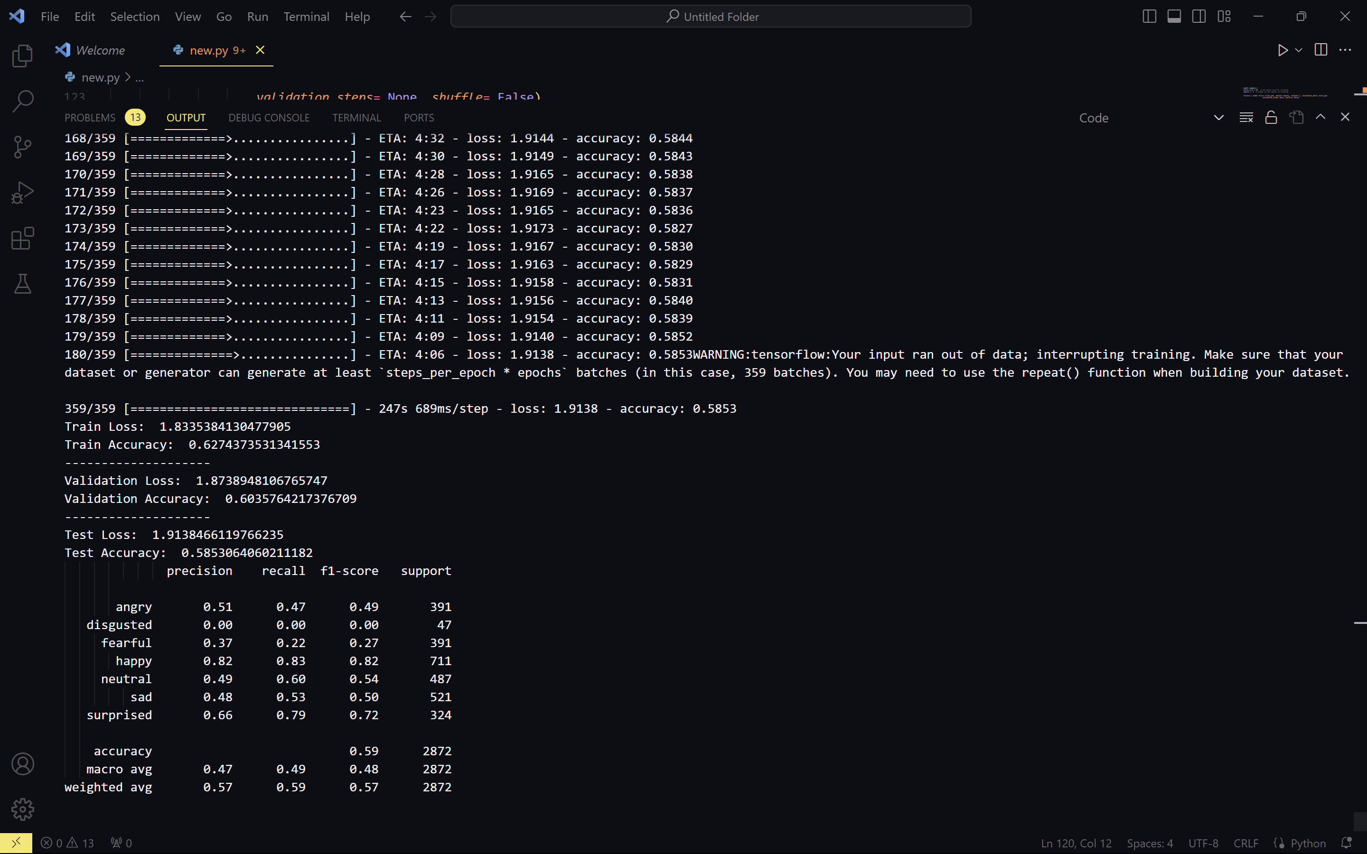

Slide 15
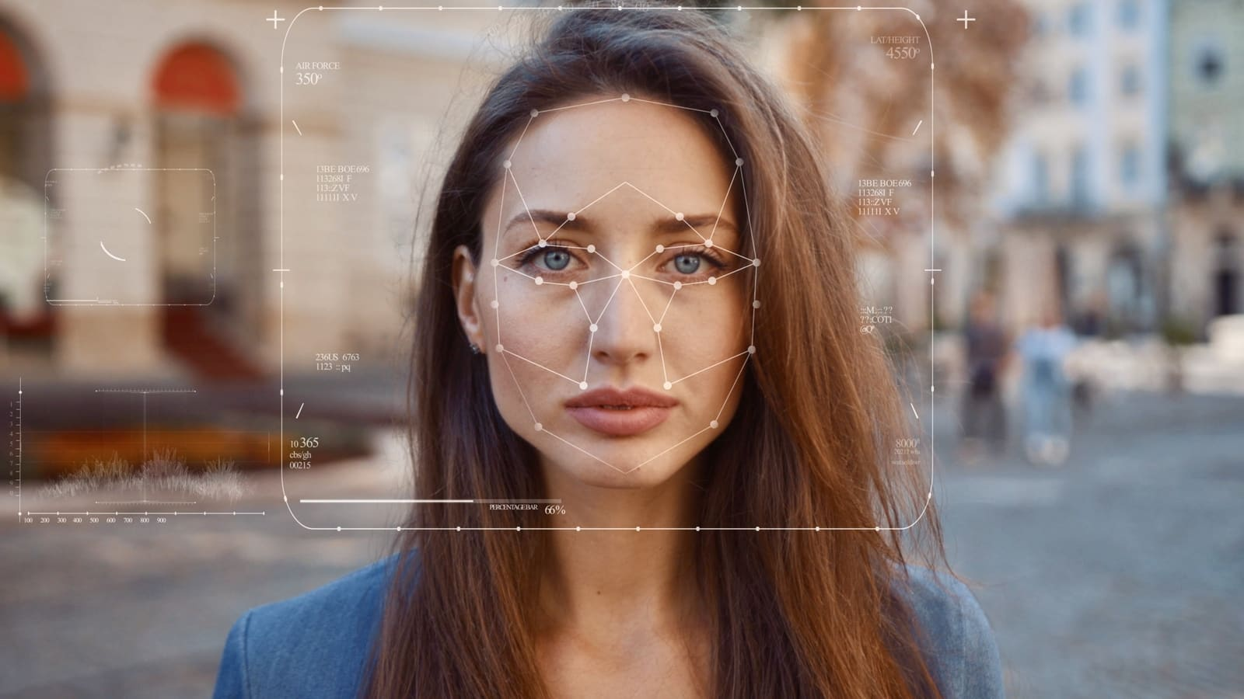

Future Directions
The future of emotion detection lies in
. By combining facial expressions, voice analysis, and physiological signals, we can achieve more comprehensive emotion understanding. Advancements in
will also make deep learning models more transparent
and interpretable. As technology evolves, emotion detection will continue to shape our interactions and understanding of human emotions.

Slide 16



Enhancing User Experiences
Emotion detection can revolutionize user experiences. From that adapt to users' moods to
that tailor content, deep
learning enables personalized and empathetic interactions. By unlocking the power of deep learning in emotion detection, we can create a future where technology understands and responds to our emotions, enhancing our overall well- being.

Slide 17


Real-World Examples
Let's explore some real-world examples of emotion detection in action. From
for job candidate
evaluation to
for mental health treatment, deep learning is transforming industries. These
examples showcase the potential and impact of emotion detection in enhancing understanding and improving human experiences.

Slide 18
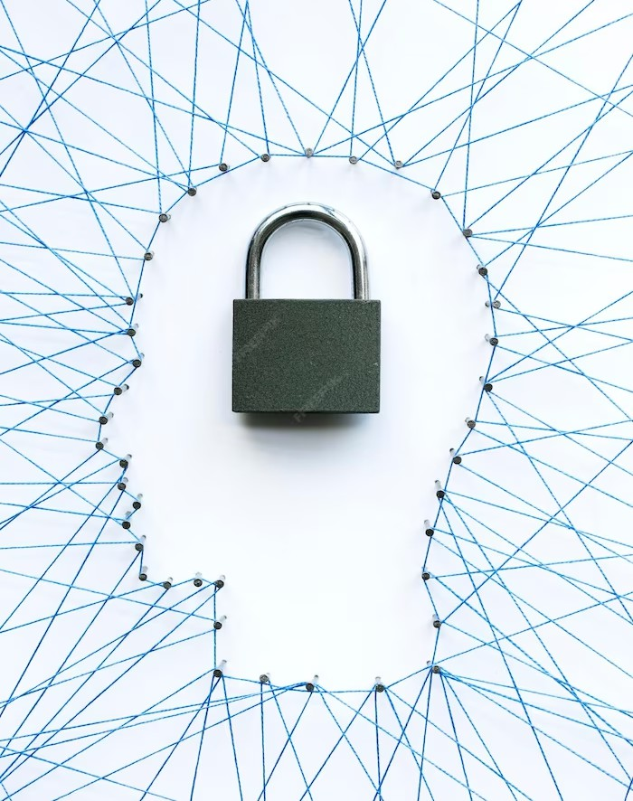



Ethical Considerations
As we integrate emotion detection into various domains, ethical considerations arise.
and are crucial when dealing with personal emotions. Bias and fairness in
emotion detection algorithms must be
addressed to avoid discrimination. Transparency and accountability in the development and deployment of emotion detection systems are
necessary for responsible and ethical use.

Slide 19
Conclusion
Deep learning-based emotion detection has the potential to revolutionize how we understand and interact with human emotions. By accurately recognizing emotions, we can create more empathetic and personalized experiences in various domains. However, it is essential to address challenges, consider ethical implications, and continue advancing the field responsibly.
Together, let's unlock the power of deep learning for enhanced understanding of emotions.

